Slide 1
CSE 3400 - Introduction to Computer & Network Security (aka: Introduction to Cybersecurity) Lecture 10 Public Key Cryptography– Part I
Ghada Almashaqbeh
UConn
From Textbook Slides by Prof. Amir Herzberg
UConn

Slide 2
Outline
Number theory review.
Intro to public key cryptography.
Key exchange.
Hardness assumptions: DL, CDH, DDH.
2

Slide 3
Number Theory Review
3

Slide 4
Our Focus
A brief overview of mainly modular arithmetic.
The minimalist set we need in topics covered in this course.
4

Slide 5
The Modulo Operation
Properties (make it easier to compute complex modular arithmetic expressions):
5

Slide 6
The Modulo Operation
Properties (extends also to polynomials):
6

Slide 7
Examples
7 mod 9 = ?
13 mod 8 = ?
0 mod 11 = ?
4 mod 4 = ?
(30 + 66) mod 11 = ?
How about: ?
7

Slide 9
Multiplicative Inverse
Needed to support division in modular arithmetic.
Division not always produce integers.
Modular arithmetic requires integers to work with!!
To compute a/b mod m, multiply a by the multiplicative inverse of b.
That is compute ab mod m = ab⁻¹ mod m.
Where b⁻¹ is the multiplicative inverse such that bb⁻¹ mod m = 1
Not all integers have multiplicative inverses with respect to a specific modulus m.
9

Slide 10
Multiplicative Inverse
If and only if x and m are a coprime.
Examples:
3/5 mod 4 = 3 . 5⁻¹ mod 4 = ?
3/5 mod 6 = 3 . 5⁻¹ mod 6 = ?
Such an algorithm is called the Extended Euclidean algorithm (out of scope for this course).
10

Slide 12
Modular Exponentiation
Will be encountered a lot; discrete log based scheme, RSA, etc.
We have seen a property to reduce the base, but how about the exponent?
Its reduction will be with respect to a different modulus than the one in the original operation.
Fermat’s Little Theorem:
12

Slide 13
Modular Exponentiation
Examples; Use Fermat’s Little theorem (if applicable) to solve the following:
13³² mod 31 = ?
19⁹³⁰ mod 4 = ?
19⁶⁰ mod 7 = ?
Can we reduce the exponent for non prime (composite) modulus?
We can use Euler’s Theorem.
13

Slide 15
Euler’s Function
Called also Euler’s Totient function. For every integer n > 1, this function computes the number of positive integers that are less than n and co-prime to n.
Examples:
15

Slide 16
Euler’s Function Properties
16

Slide 17
Euler’s Theorem
Examples:
13³¹ mod 31 = ?
27²⁶ mod 10 = ?
17

Slide 18
Last Stop
Congruence:
Used when two expressions have the same residue with respect to some modulus.
It is an equivalence relation, so it satisfies:
Lastly, we have the fundamental theorem of arithmetic.
18

Slide 19
Intro to Public Key Cryptography
19

Slide 20
Public Key Cryptology
Kerckhoff: cryptosystem (algorithm) is public
What we learned until now:
Only the key is secret (unknown to attacker)
Same key for encryption, decryption ➔ if you can encrypt, you can also decrypt!
But can we give encryption capability without a decryption capability?
Yes, using public key cryptography!

Slide 21
Public Key Cryptosystem (PKC)
Kerckhoff: cryptosystem (algorithm) is public
[DH76]: can encryption key be public, too??
Decryption key will be different (and private)
Everybody can send me mail, only I can read it.
Key length l
KeyGen KG
Encryption Key e
(public)
(e,d)
Decryption Key d
(private)
e
d
Plaintext
m
Encrypt E
Ciphertext c=E_{e}(m)
Decrypt D
Plaintext m=D_{d}(E_{e}(m))

Slide 22
Is it Only About Encryption?
Also: Digital signatures (RSA, DSA,…)
Sign with private key s, verify with public key v
(Recall MACs; a shared key cryptosystem for message authentication).
Key length l
KeyGen KG
Private signing key s
(s,v)
Public validation
key v
s
v
Message
m
Sign S
m, σ=S_{s}(m)
Validate V
m if V_{v}(m, σ)=OK
Error otherwise

Slide 23
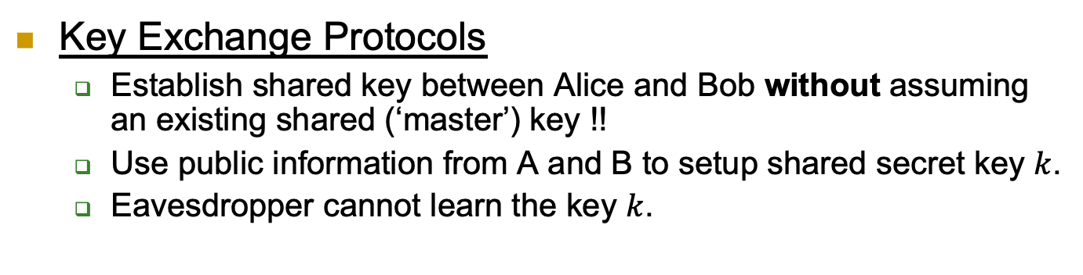
More: Key-Exchange Protocol
Key Exchange Protocols
Establish shared key between Alice and Bob without assuming an existing shared (‘master’) key !!
Use public information from A and B to setup shared secret key $k$.
Eavesdropper cannot learn the key $k$.

Slide 24
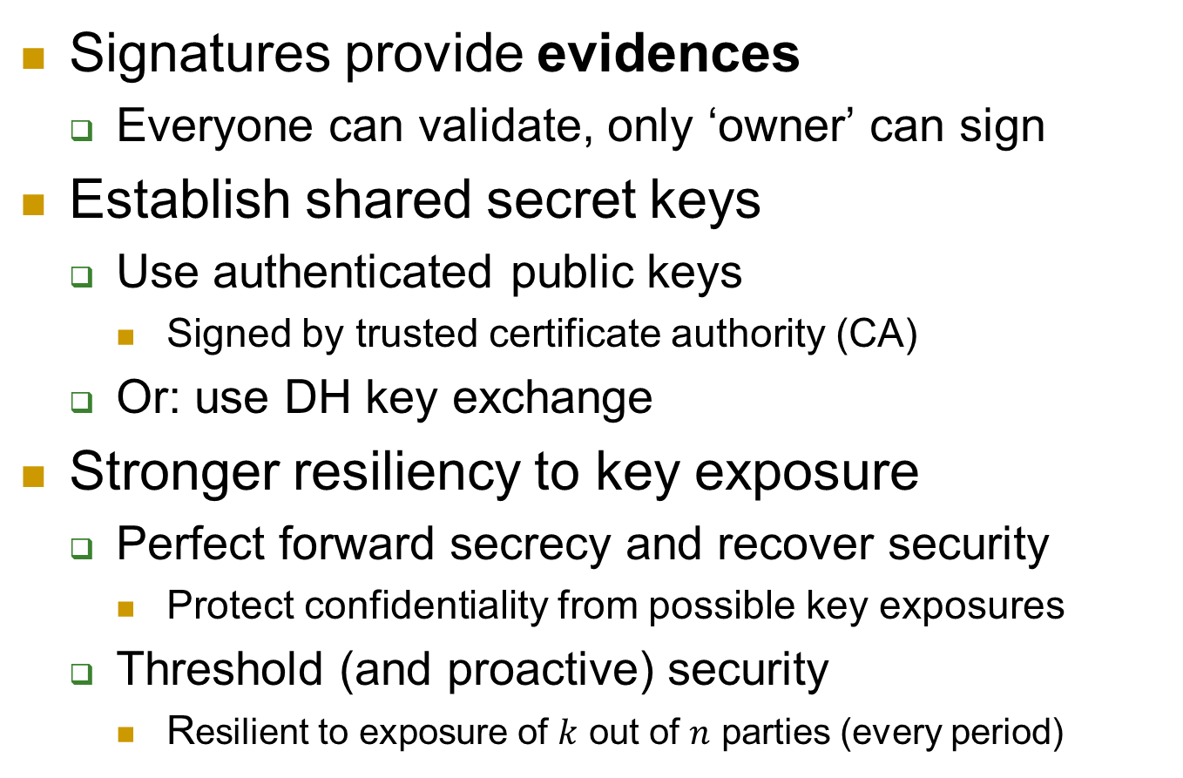
Public keys solve more problems…
Signatures provide evidences
Everyone can validate, only ‘owner’ can sign
Establish shared secret keys
Use authenticated public keys
Signed by trusted certificate authority (CA)
Or: use DH key exchange
Stronger resiliency to key exposure
Perfect forward secrecy and recover security
Protect confidentiality from possible key exposures
Threshold (and proactive) security
Resilient to exposure of $k$ out of $n$ parties (every period)

Slide 25
Public keys are easier…
To distribute:
From directory or from incoming message (still need to be authenticated)
Less keys to distribute (same public key to all)
To maintain:
Can keep in non-secure storage as long as being validated (e.g. using MAC) before using
Less keys: O(|parties|), not O(|parties|²)
So: why not always use public key crypto?

Slide 26
The Price of PKC
Assumptions
Applied PKC algorithms are based on a small number of specific computational assumptions
Mainly: hardness of factoring and discrete-log
Both may fail against quantum computers
Overhead
Computational
Key length
Output length (ciphertext/signature)

Slide 27
Public key crypto is harder…
Requires related public, private keys
Private key `reverses` public key
Public key does not expose private key
Substantial overhead
Successful cryptanalytic shortcuts → need long keys
Elliptic Curves (EC) may allow shorter key (almost no shortcuts found)
Complex computations
RSA: very complex (slow) key generation
Most: based on hard modular math problems
[LV02] | Required key size
Year | AES | RSA, DH | EC
2010 | 78 | 1369 | 160
2020 | 86 | 1881 | 161
2030 | 93 | 2493 | 176
2040 | 101 | 3214 | 191
Commercial-grade security Lenstra & Verheul [LV02]

Slide 28
In Sum
Minimize the use of PKC
In particular: apply PKC only to short inputs
How ??
For signatures:
Hash-then-sign
For public-key encryption:
Hybrid encryption

Slide 29
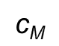
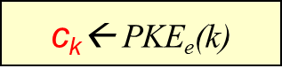
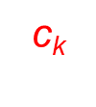
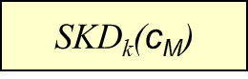
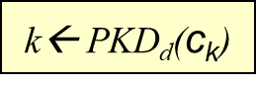
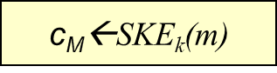
Hybrid Encryption (`enveloping`)
Challenge: public key cryptosystems are slow
Hybrid encryption:
Use a shared key encryption scheme to encrypt all messages.
But use a public key encryption system to exchange the shared key (Alice generates the k, encrypt it under Bob’s public key and send it to Bob, Bob can then recover this key).
Encryption
Decryption
k ←{0,1}^{n}
$$\text{c}\text{k}$$
$\text{c}\text{k}$← PKE_{e}(k)
k← PKD_{d}($\text{c}\text{k}$)
Plaintext m
$$\text{c}\text{M}$$
m
$\text{c}\text{M}$←SKE_{k}(m)
SKD_{k}($\text{c}\text{M}$)
Notes:
29
10/30/11

Slide 30
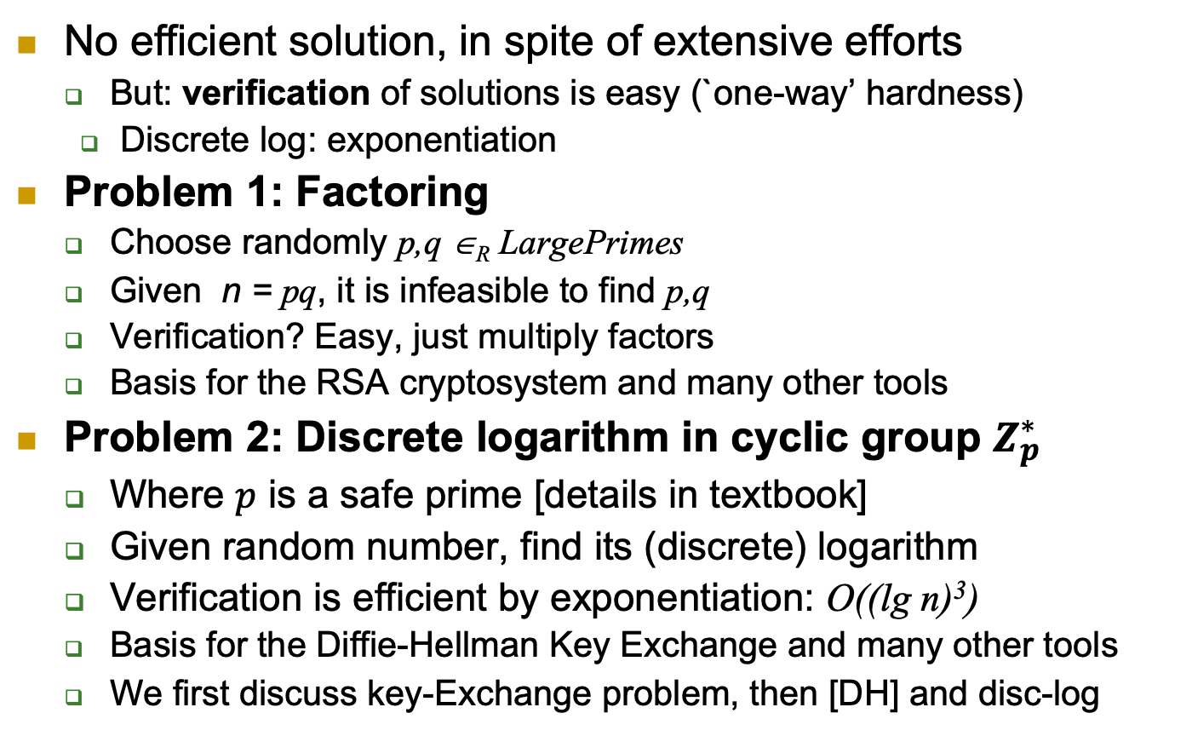
Hard Modular Math Problems
No efficient solution, in spite of extensive efforts
But: verification of solutions is easy (`one-way’ hardness)
Discrete log: exponentiation
Problem 1: Factoring
Choose randomly p,q ∈_{R} LargePrimes
Given n = pq, it is infeasible to find p,q
Verification? Easy, just multiply factors
Basis for the RSA cryptosystem and many other tools
Problem 2: Discrete logarithm in cyclic group $Z_{p}^{∗}$
Where $p$ is a safe prime [details in textbook]
Given random number, find its (discrete) logarithm
Verification is efficient by exponentiation: O((lg n)³)
Basis for the Diffie-Hellman Key Exchange and many other tools
We first discuss key-Exchange problem, then [DH] and disc-log

Slide 31
Key Exchange
31

Slide 32



The Key Exchange Problem
Aka key agreement
Alice and Bob want to agree on secret (key)
Secure against eavesdropper adversary
Assume no prior shared secrets (key)
Otherwise seems trivial
Actually, we’ll later show it’s also useful in this case…

Slide 33
Defining a Key Exchange Protocol
Must satisfy correctness; both parties compute the same shared key, and key indistinguishability (see next slide).

Slide 34
Security a Key Exchange Protocol

Slide 35
Discrete Log (DL) Assumption and The Computational/Decisional Diffie-Hellman Assumptions (CDH/DDH) and The DH Key Exchange Protocol
35

Slide 36
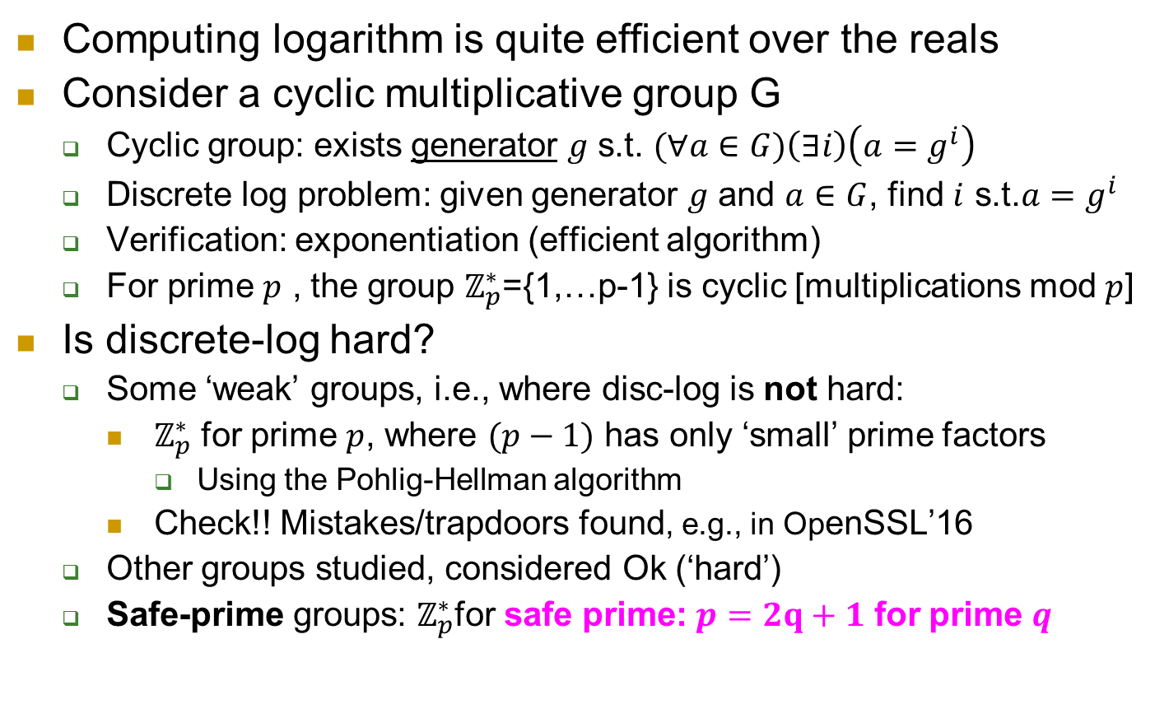
The Discrete Log Problem
Computing logarithm is quite efficient over the reals
Consider a cyclic multiplicative group G
Cyclic group: exists generator $g$ s.t. $(∀a∈G)\left(∃i\right)\left(a=g^{i}\right)$
Discrete log problem: given generator $g$ and $a∈G$, find $i$ s.t.$a=g^{i}$
Verification: exponentiation (efficient algorithm)
For prime $p$ , the group $ℤ_{p}^{∗}$={1,…p-1} is cyclic [multiplications mod $p$]
Is discrete-log hard?
Some ‘weak’ groups, i.e., where disc-log is not hard:
$ℤ_{p}^{∗}$ for prime $p$, where $(p−1)$ has only ‘small’ prime factors
Using the Pohlig-Hellman algorithm
Check!! Mistakes/trapdoors found, e.g., in OpenSSL’16
Other groups studied, considered Ok (‘hard’)
Safe-prime groups: $ℤ_{p}^{∗}$for safe prime: $p=2q+1$ for prime $q$
Notes:
$ℤ_{p}^{∗}$ contains element of$ℤ_{p}^{}$ which are relatively-prime to p, i.e., gcd(a,p)=1; for prime p this holds for entire $ℤ_{p}^{}, i.e.ℤ_{p}^{∗}=ℤ_{p}^{}$
Evidences of intentional manipulation of crypto choices in few cases, e.g., Juniper Network ‘16.

Slide 37

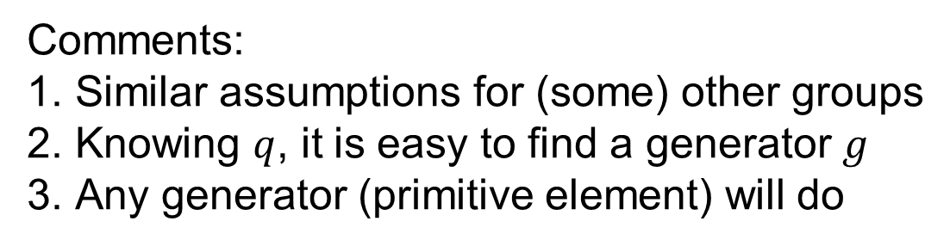
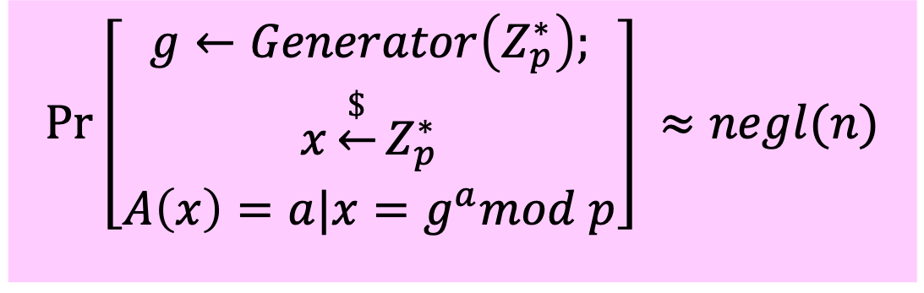
Discrete Log Assumption [for safe prime group: $p=2q+1$ for prime $q$]
Given PPT adversary A, and n-bit safe prime p:
$$Pr\left[\begin{matrix}g←Generator\left(Z_{p}^{∗}\right); \\ x\underset{←}{\$}Z_{p}^{∗} \\ A\left(x\right)=a|{x=g}^{a}mod p\end{matrix}\right]⁡≈negl(n)$$
Comments:
Similar assumptions for (some) other groups
Knowing $q$, it is easy to find a generator $g$
Any generator (primitive element) will do

Slide 38
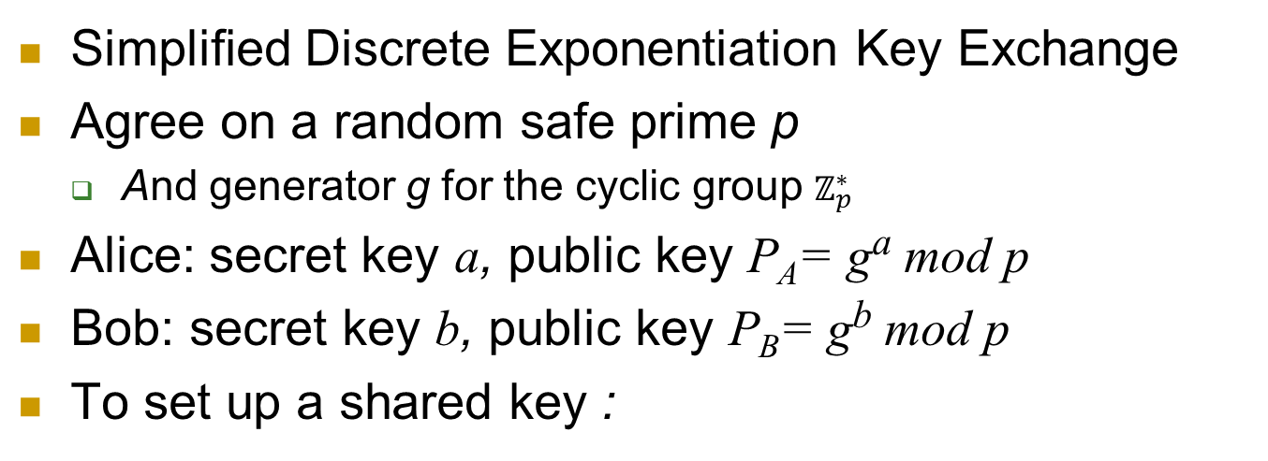
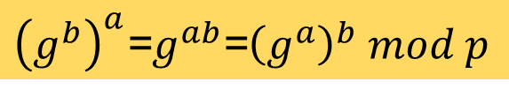
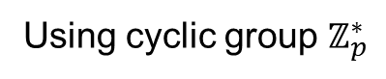
Diffie-Hellman [DH] Key Exchange
Using cyclic group $ℤ_{p}^{∗}$
Simplified Discrete Exponentiation Key Exchange
Agree on a random safe prime p
And generator g for the cyclic group $ℤ_{p}^{∗}$
Alice: secret key a, public key P_{A}= gª mod p
Bob: secret key b, public key P_{B}= g^{b} mod p
To set up a shared key :
Alice
Bob
Select a
P_{A}= gª mod p
Select b
P_{B}= g^{b} mod p
${\left(g^{b}\right)}^{a}$=$g^{ab}$=${\left(g^{a}\right)}^{b} mod p$

Slide 39
Caution: Authenticate Public Keys!
Diffie-Hellman key exchange is only secure using the authentic public keys
Or (equivalently): against eavesdropper
If Bob simply receives Alice’s public key, [DH] is vulnerable to `Man in the Middle` attack

Slide 40
Security of [DH] Key Exchange
Assume authenticated communication
Based on Computational Discrete Log Assumption
But DH requires stronger assumption than Disc-Log:
Maybe from g^{b} mod p and gª mod p, adversary can compute g^{ab} mod p (without knowing/learning a,b or ab)?
P_{A}=gª mod p
Alice
Bob
P_{B}=g^{b} mod p

Slide 41

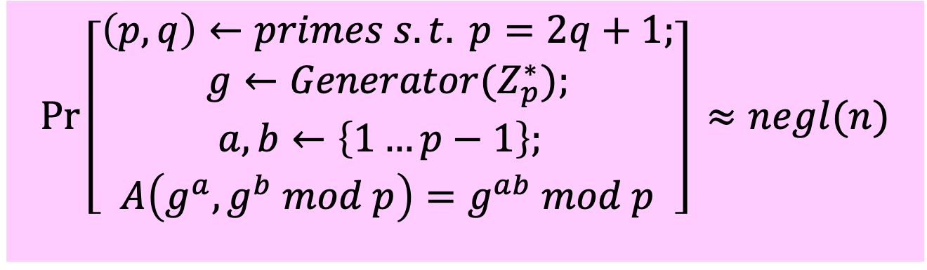

Computational DH (CDH) Assumption [for safe prime group]
Given PPT adversary A:
$$Pr\left[\begin{aligned}\left(p,q\right)←primes s.t. p=2q+1; \\ g←Generator{(Z}_{p}^{∗}); \\ a,b←\left\{1…p−1\right\}; \\ A\left(g^{a},g^{b} mod p\right)=g^{ab} mod p\end{aligned}\right]⁡≈negl(n)$$
Assume CDH holds. Can we use $g^{ab}$as key?
Not necessarily; maybe finding some bits of $g^{ab}$ is easy?

Slide 42
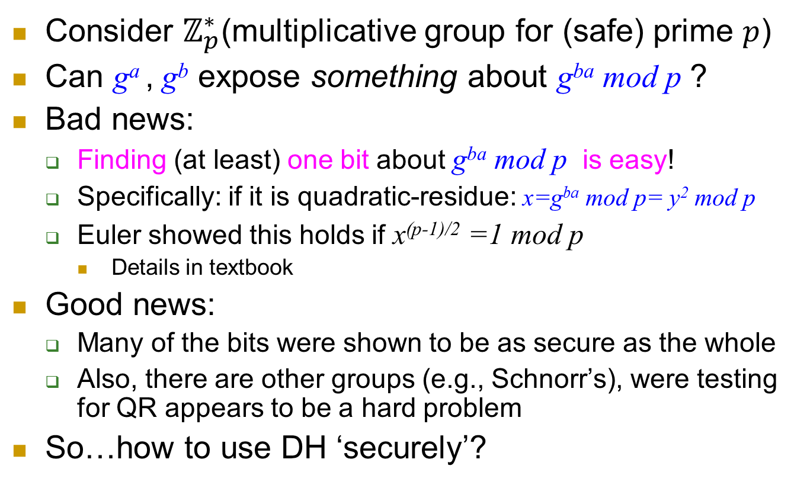
Using DH securely?
Consider $ℤ_{p}^{∗}$(multiplicative group for (safe) prime $p$)
Can gª , g^{b} expose something about g^{ba} mod p ?
Bad news:
Finding (at least) one bit about g^{ba} mod p is easy!
Specifically: if it is quadratic-residue: x=g^{ba} mod p= y² mod p
Euler showed this holds if x^{(p-1)/2} =1 mod p
Details in textbook
Good news:
Many of the bits were shown to be as secure as the whole
Also, there are other groups (e.g., Schnorr’s), were testing for QR appears to be a hard problem
So…how to use DH ‘securely’?
Notes:
Exercise: show how to compute Legenre of g^ab !

Slide 43
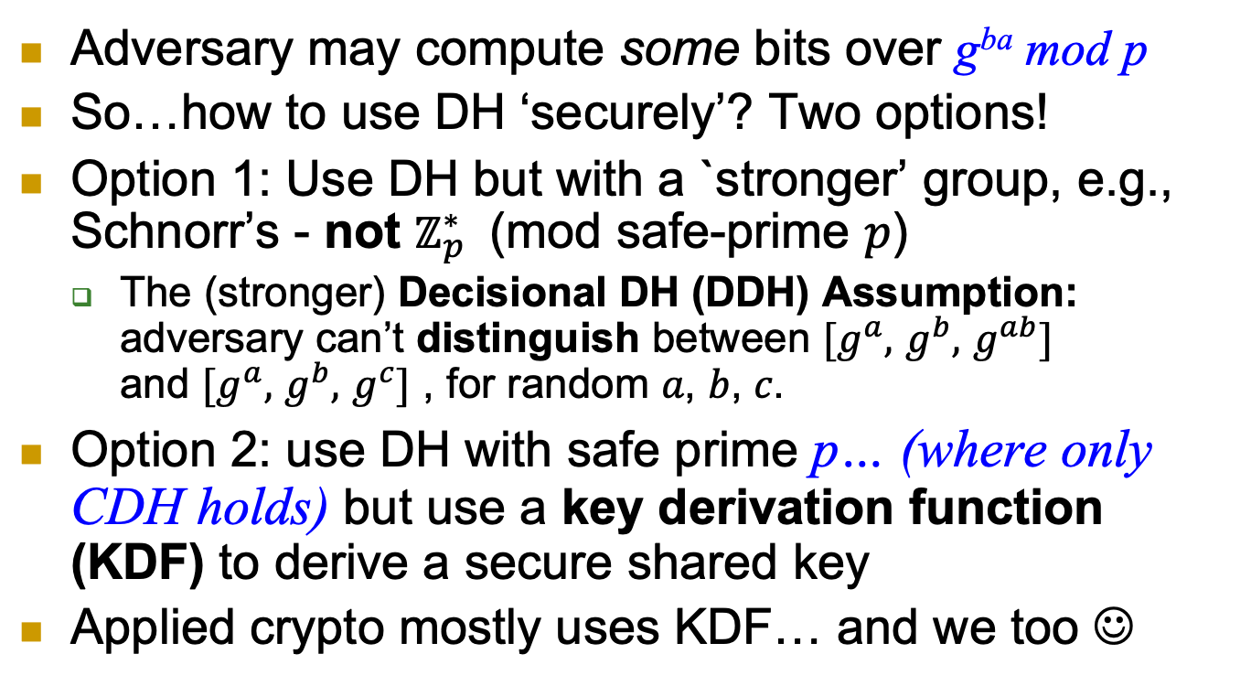
Using DH securely?
Adversary may compute some bits over g^{ba} mod p
So…how to use DH ‘securely’? Two options!
Option 1: Use DH but with a `stronger’ group, e.g., Schnorr’s - not $ℤ_{p}^{∗}$ (mod safe-prime $p$)
The (stronger) Decisional DH (DDH) Assumption: adversary can’t distinguish between $[g^{a},$ $g^{b},$ $g^{ab}]$ and $[g^{a},$ $g^{b},$ $g^{c}]$ , for random 𝑎, 𝑏, 𝑐.
Option 2: use DH with safe prime p… (where only CDH holds) but use a key derivation function (KDF) to derive a secure shared key
Applied crypto mostly uses KDF… and we too ☺
Notes:
Exercise: show how to compute Legenre of g^ab !

Slide 44
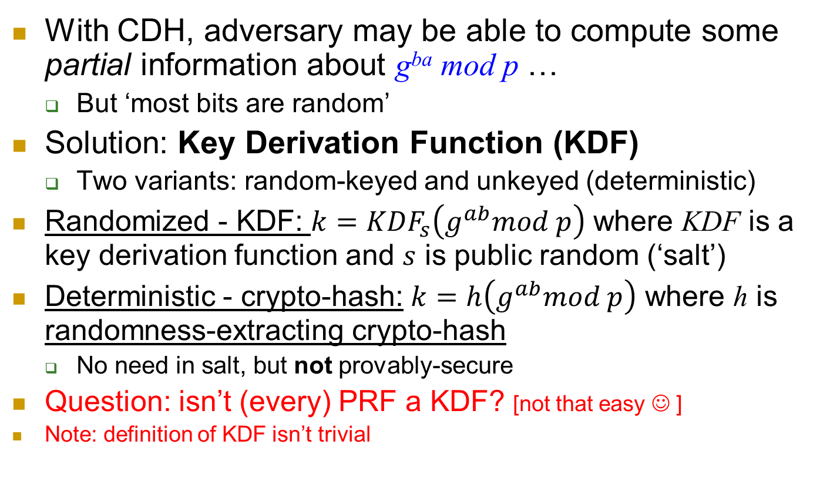
Using DH ‘securely’: CDH+KDF
With CDH, adversary may be able to compute some partial information about g^{ba} mod p …
But ‘most bits are random’
Solution: Key Derivation Function (KDF)
Two variants: random-keyed and unkeyed (deterministic)
Randomized - KDF: $k={KDF}_{s}\left(g^{ab}mod p\right)$ where KDF is a key derivation function and $s$ is public random (‘salt’)
Deterministic - crypto-hash: $k=h\left(g^{ab}mod p\right)$ where h is randomness-extracting crypto-hash
No need in salt, but not provably-secure
Question: isn’t (every) PRF a KDF? [not that easy ☺ ]
Note: definition of KDF isn’t trivial

Slide 45
Resilience to Key Exposure
45

Slide 46
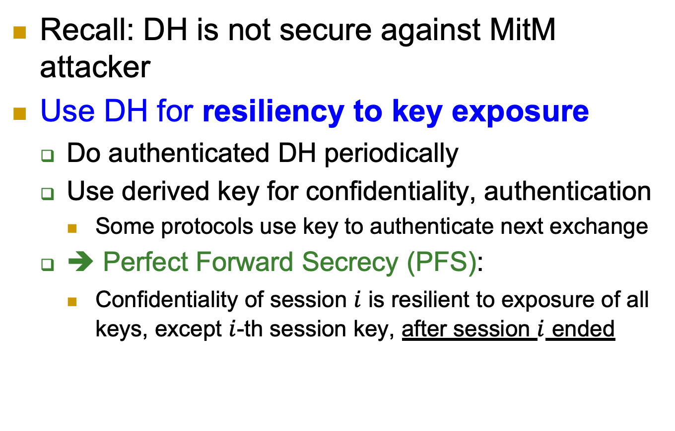
Authenticated DH
Recall: DH is not secure against MitM attacker
Use DH for resiliency to key exposure
Do authenticated DH periodically
Use derived key for confidentiality, authentication
Some protocols use key to authenticate next exchange
➔ Perfect Forward Secrecy (PFS):
Confidentiality of session $i$ is resilient to exposure of all keys, except $i$-th session key, after session $i$ ended

Slide 47
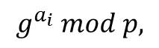
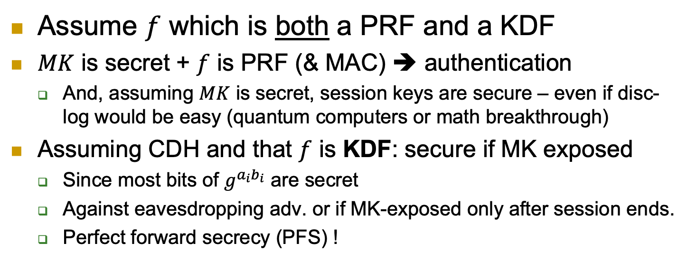
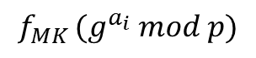
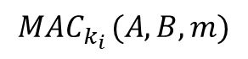

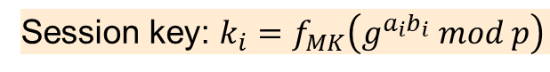
Authenticated DH: using KDF/PRF [TLS]
Assume $f$ which is both a PRF and a KDF
$MK$ is secret + $f$ is PRF (& MAC) ➔ authentication
And, assuming $MK$ is secret, session keys are secure – even if disc-log would be easy (quantum computers or math breakthrough)
Assuming CDH and that $f$ is KDF: secure if MK exposed
Since most bits of $g^{a_{i}b_{i}}$ are secret
Against eavesdropping adv. or if MK-exposed only after session ends.
Perfect forward secrecy (PFS) !
Alice
$$g^{a_{i}} mod p,$$
$$f_{MK} (g^{a_{i}} mod p)$$
Bob
$$g^{b_{i}} mod p, f_{MK} (g^{b_{i}} mod p)$$
Session key: $k_{i}=f_{MK}\left(g^{a_{i}b_{i}} mod p\right)$
$${MAC}_{k_{i}} (A,B,m)$$
Notes:
Assuming hash is a random function we could also simply use $k_{i}=h(g^{a_{i}b_{i}}) mod p$

Slide 48


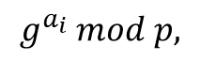
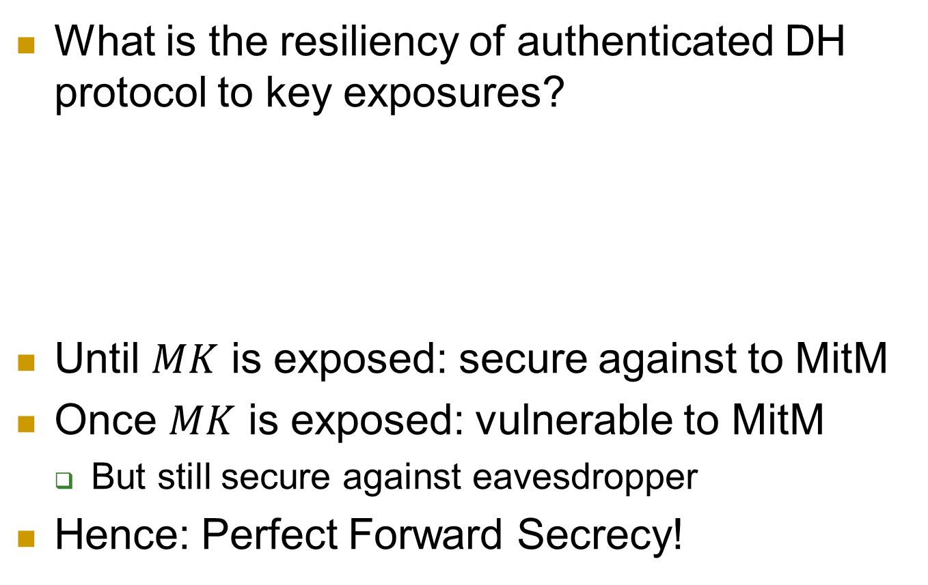
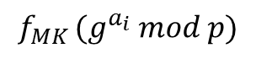
Using DH for Exposure-Resiliency
What is the resiliency of authenticated DH protocol to key exposures?
Until $MK$ is exposed: secure against to MitM
Once $MK$ is exposed: vulnerable to MitM
But still secure against eavesdropper
Hence: Perfect Forward Secrecy!
Alice
$$g^{a_{i}} mod p,$$
$$f_{MK} (g^{a_{i}} mod p)$$
Bob
$$g^{b_{i}} mod p, f_{MK} (g^{b_{i}} mod p)$$
Session key: $k_{i}=f_{MK}\left(g^{a_{i}b_{i}} mod p\right)$

Slide 49

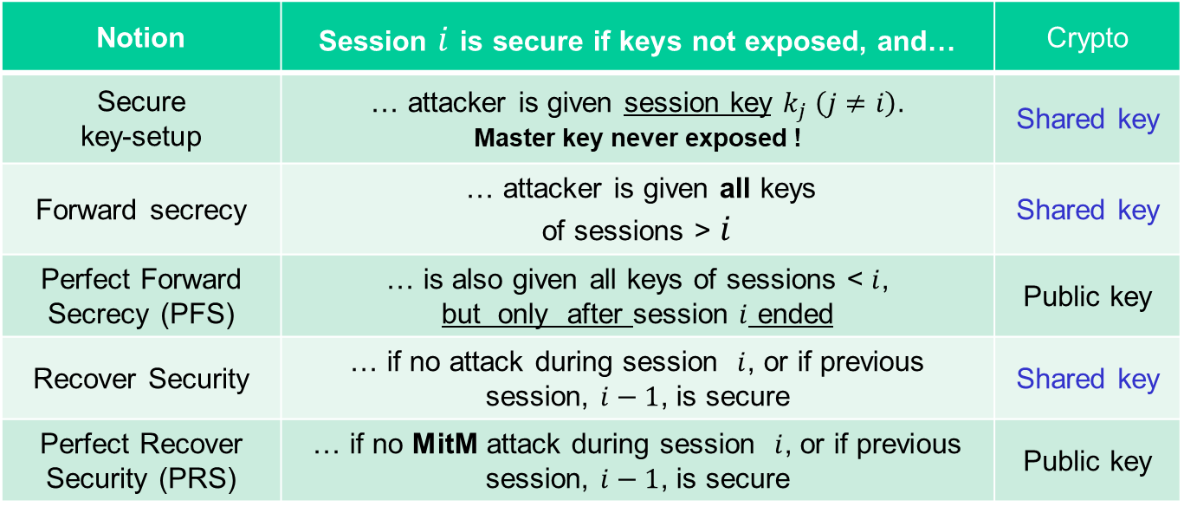
Resiliency Notions: Shared + Public Key
Notion | Session $i$ is secure if keys not exposed, and… | Crypto
Secure key-setup | … attacker is given session key $k_{j} \left(j≠i\right)$. Master key never exposed ! | Shared key
Forward secrecy | … attacker is given all keys of sessions > $i$ | Shared key
Perfect Forward Secrecy (PFS) | … is also given all keys of sessions < $i$, but only after session $i$ ended | Public key
Recover Security | … if no attack during session $i$, or if previous session, $i−1$, is secure | Shared key
Perfect Recover Security (PRS) | … if no MitM attack during session $i$, or if previous session, $i−1$, is secure | Public key
No!
Why?
Exposing master key
makes all future session vulnerable to MitM
Secure key setup
FS
PFS
RS
PRS
Notes:
49
(c) Amir Herzberg, http://AmirHerzberg.com, Bar Ilan University
11/13/11
`Perfect’ is not really the right term… but that’s the commonly used term.

Slide 50
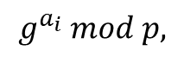
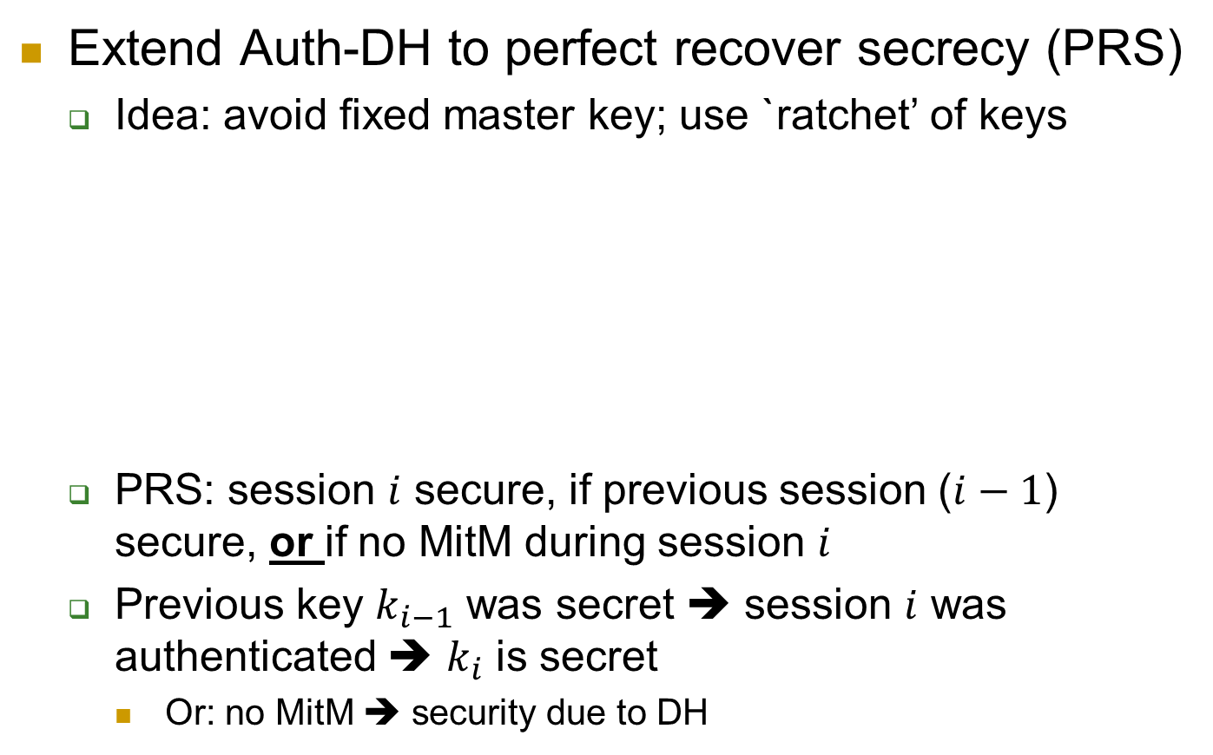
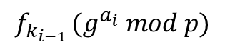
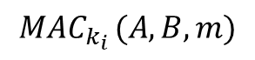

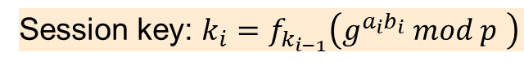
Perfect Recover Secrecy: Ratchet DH
Extend Auth-DH to perfect recover secrecy (PRS)
Idea: avoid fixed master key; use `ratchet’ of keys
PRS: session $i$ secure, if previous session ($i−1$) secure, or if no MitM during session $i$
Previous key $k_{i−1}$ was secret ➔ session $i$ was authenticated ➔ $k_{i}$ is secret
Or: no MitM ➔ security due to DH
Alice
$$g^{a_{i}} mod p,$$
$$f_{k_{i−1}} (g^{a_{i}} mod p)$$
Bob
$$g^{b_{i}} mod p, f_{k_{i−1}} (g^{b_{i}} mod p)$$
Session key: $k_{i}=f_{k_{i−1}}\left(g^{a_{i}b_{i}} mod p \right)$
$${MAC}_{k_{i}} (A,B,m)$$
Notes:
[*] Why is sending f_MK(…) enough to authenticate (assuming MK is secret)? Could we use any MAC instead, and use f_MK only to derive key (k_i)?
Assuming hash is a random function we could also simply use $k_{i}=h(g^{a_{i}b_{i}}) mod p$

Slide 51
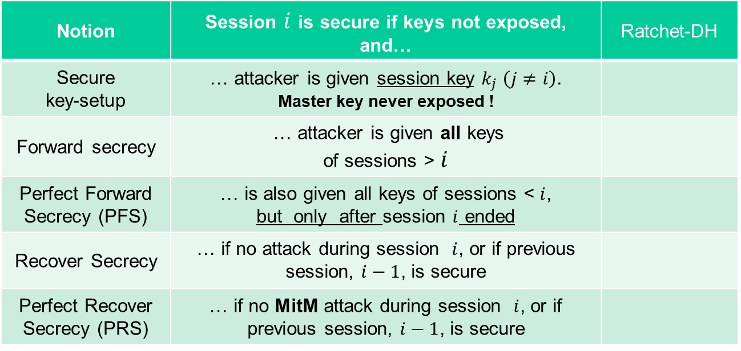
Ratchet-DH’s Exposure-Resiliency
Notion | Session $i$ is secure if keys not exposed, and… | Ratchet-DH
Secure key-setup | … attacker is given session key $k_{j} \left(j≠i\right)$. Master key never exposed !
Forward secrecy | … attacker is given all keys of sessions > $i$
Perfect Forward Secrecy (PFS) | … is also given all keys of sessions < $i$, but only after session $i$ ended
Recover Secrecy | … if no attack during session $i$, or if previous session, $i−1$, is secure
Perfect Recover Secrecy (PRS) | … if no MitM attack during session $i$, or if previous session, $i−1$, is secure
Notes:
51
(c) Amir Herzberg, http://AmirHerzberg.com, Bar Ilan University
11/13/11
`Perfect’ is not really the right term… but that’s the commonly used term.

Slide 52
Covered Material From the Textbook
Appendix A.2
Chapter 6: sections 6.1, 6.2, and 6.3

Slide 53

Thank You!

